Slide 1
LTV Specification Meeting
Samantha B. Green
February 12, 2020

Slide 2
MEETING AGENDA
LTV SPECIFICATIONS
Define the kind of vehicle your System needs.
Learn what is available on the market.
Write specifications that accurately describe your requirements.
Announce your Invitation for Bids
Develop a Quality Assurance checklist.

Slide 3
VEHICLE Procurement

Slide 4
WRITING SPECIFICATIONS
LTV SPECIFICATION MEETING

Slide 5
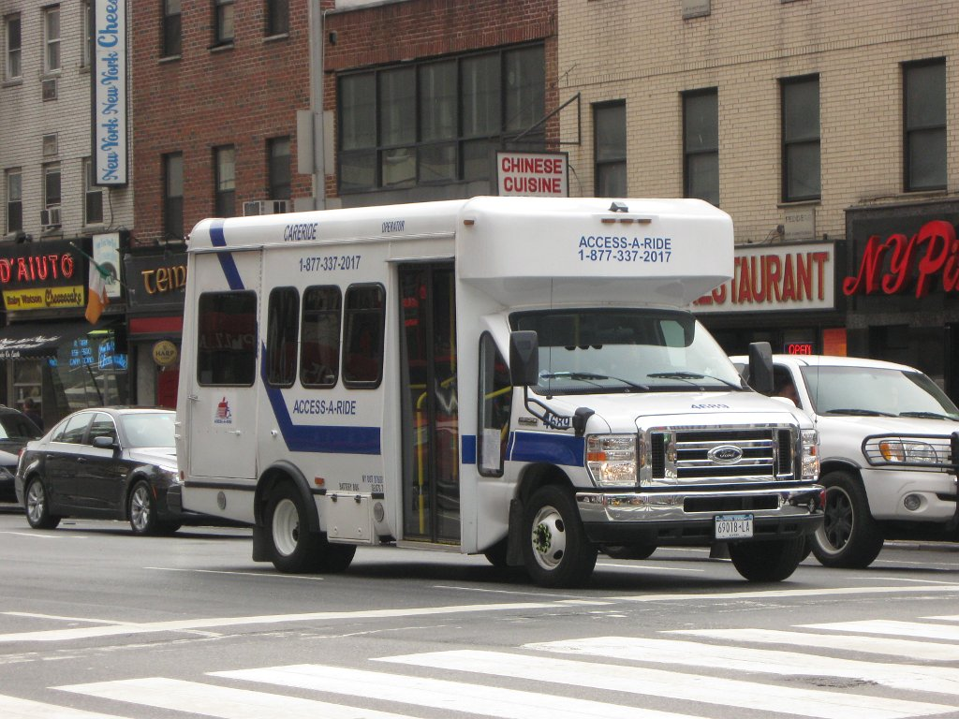
VEHICLE PROCUREMENT
Requirements and compliance
Pre-Award/Post-Delivery Audits
ADA Compliant
Buy America/Rolling Stock – Federal Requirements
Chassis
Body (exterior)
Body (SEinterior, Floor design)
Equipment (standard) mirrors, lights, heaters, windshield wipers and fans.
Equipment (special) back-up alarm, rustproofing, first-aid kit, wheel wrench and jack, fire extinguisher, emergency reflectors, AC, WC-lift and WC securement devices.
This Photo by Unknown Author is licensed under CC BY-SA

